Slide 1
Try & Catch

Slide 2
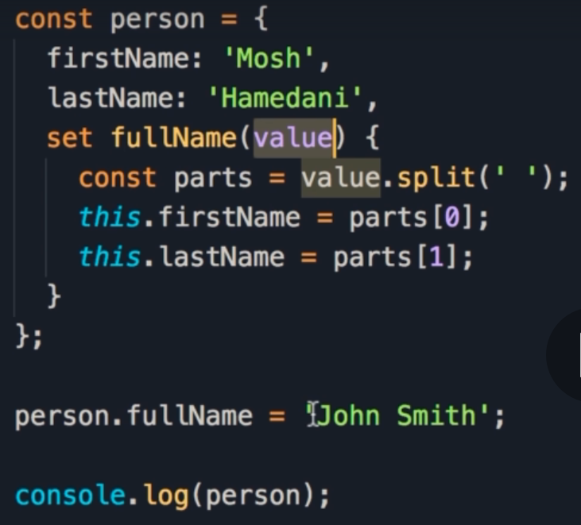
Error Handling
In the previous discussion, we assumed that the value received in the setter is a valid string.
Notes:
In the last lecture we assume that the value that we receive here is a valid string.

Slide 3
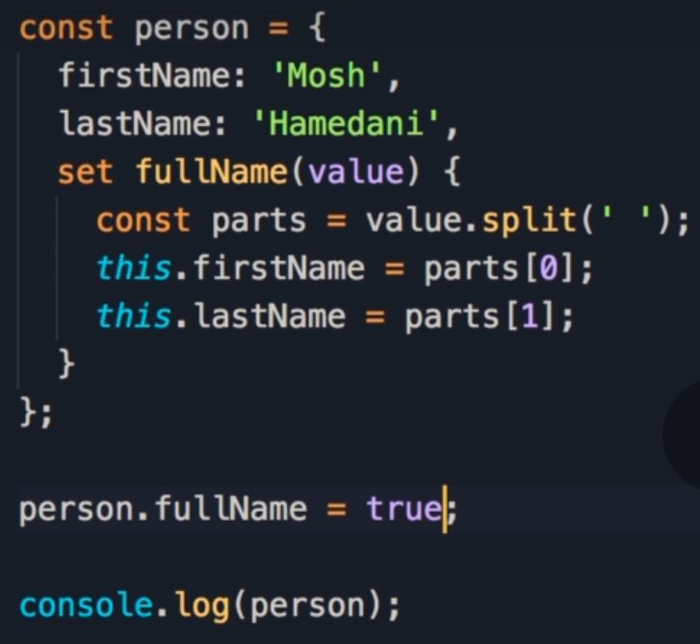
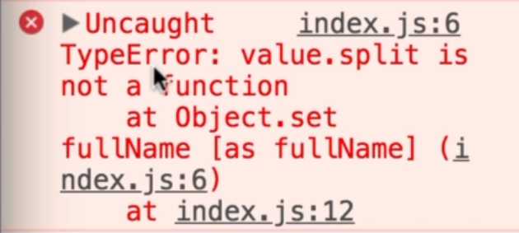
Passing an invalid value
Here we attempt to pass a boolean value.
When we run this code, we get an error:
Uncaught TypeError: value.split is not a function
This is because split is a method that belongs to strings, and booleans don’t have a split method.
Notes:
But what would happen if we pass a boolean here?
That doesn't make sense, right?
So let's run this code we get this error.
Uncaught type error, value.split is not a function.
Because split is a method that belongs to strings.
Booleans don't have a split method, right?

Slide 4
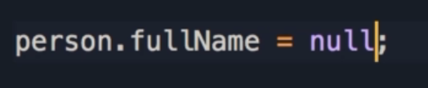
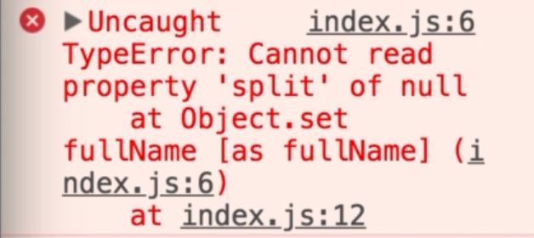
Null or Undefined
If we pass a value of null or undefined, we get a different error:
Uncaught TypeError: Cannot read property ‘split’ of null/undefiend
We cannot call the split method on null or undefined, as its only available to strings.
In these cases, we would need to add error handling.
Notes:
What would happen if we pass null or undefined?
Save the changes, we get a different error.
Cannot read property split of null.
Again, for the same reason we cannot call the split method on a null, it's only available on a string.
So here we need to add error handling.

Slide 5
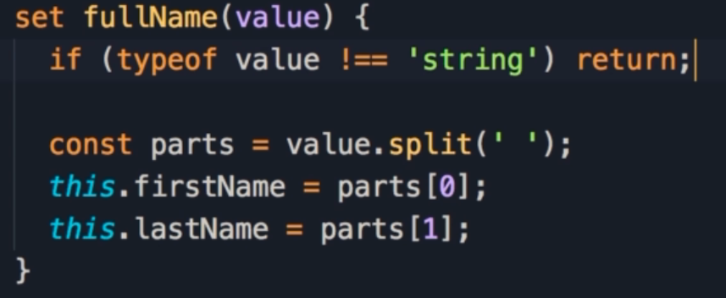
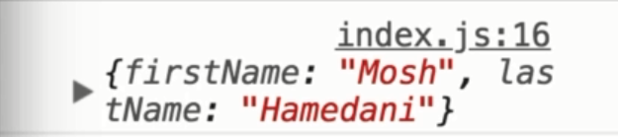
Adding error handling
In situations like this, we should do error handling at the beginning of the function or method.
This is what we call defensive programming.
We want to make sure that the values coming in are valid, they're in the right shape, so we can execute our logic.
In the first line of this method, we use the typeof operator to check if the type of value is not equal to (!==) string.
When we pass a null object, it no longer displays a message, and the object did not change
Notes:
Typically, in situations like this, we should do error handling at the beginning of a function or a method, this is what we call defensive programming.
So we want to make sure that the values coming in are valid, they're in the right shape, so we can execute our logic.
So, the first line of this method should be something like this.
You want to make sure that this value is a string.
So, we can use the type of operator, with type of value.
isNot String, then, when simple appraoch is to return and with this we'll no longer see this error message here.
Save the changes, so we can see the person object with the original first name and last name.
So what we passed here null did not take effect.

Slide 6
Displaying Errors
Sometimes we want to report an error in our application.
That’s when we need to throw an exception.
Throwing an exception is a technical jargon that you might hear in a lot of programming languages.
Let’s see how that works in JavaScript.
Notes:
But sometimes we want to report an error in our application.
That's where we need to throw an exception.
Throwing an exception is a technical jargon that you might here in a lot of programming languages.
So let's see how that works in JavaScript.

Slide 7
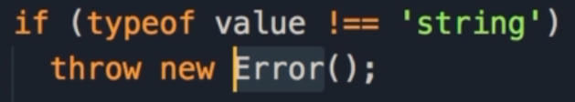
Throwing Exceptions
Instead of returning from this method, use the throw keyword and then create a new Error object.
This Error object is a constructor function, as indicated by the use of Pascal Case.
When we are calling it, we are using the new keyword to create a new Error object.
Notes:
So instead of returning from this method, use the throw keyword and then create a new error object.
So new error, that looks familiar right, so error as a constructor function, because here we have the pascal case.
And we're calling it, we're calling this function using the new operator to create a new error object. Right?

Slide 8
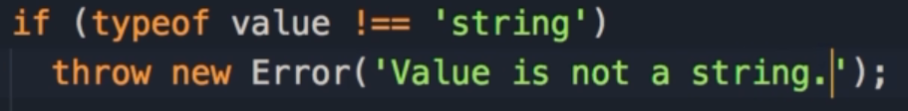
Adding the Error message
As an argument to the Error constructor, we can pass a string as the error message:
‘Value is not a string’
This is how we throw exceptions
Notes:
Now, as an argument we can pass an error message.
So value is not a string.
This is how we throw an exception,

Slide 9
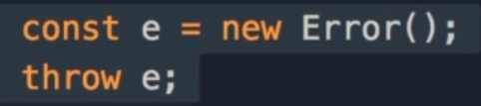
Errors & Exceptions
Some people confused errors with exceptions, but there is a slight difference between the two.
First we can create an error object and assign it to a variable called e.
This is just a plain JavaScript object, there's nothing special about this.
But the moment you throw this error, we refer to that as an exception.
Because this is an exceptional situation that should not have happened.
Notes:
now some people confused errors with exceptions, but there is a slight difference between the two, here we can create an error object, let's call it e new error.
This is just a plain JavaScript object, there's nothing special about this.
But the moment you throw this error, we refer to that as an exception.
So this is an exceptional situation that should not have happened. Okay?

Slide 10
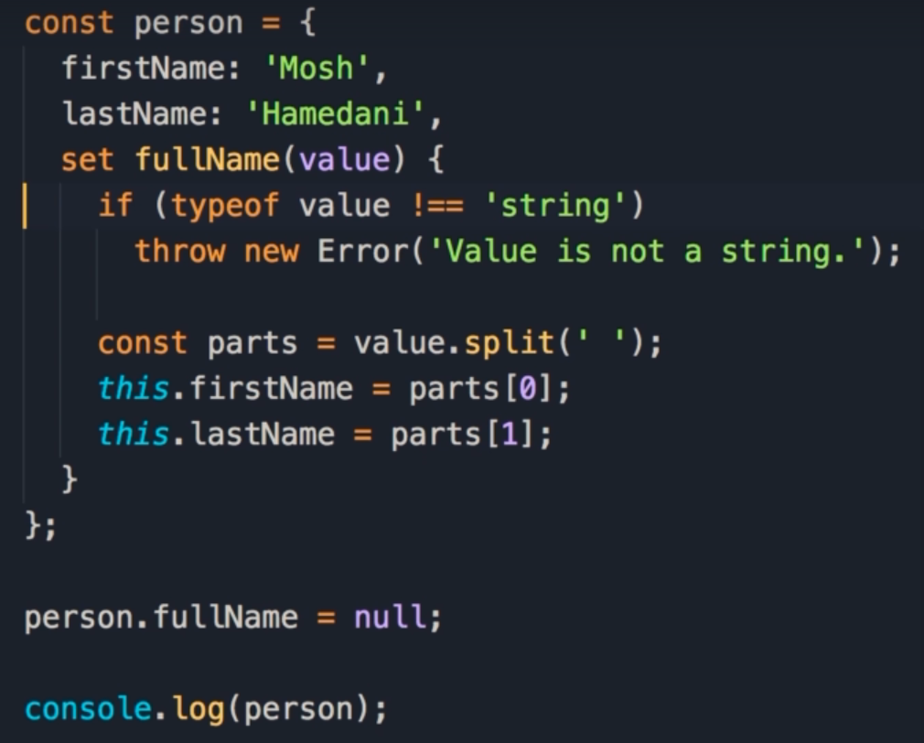
Error Handling
Now we have some basic error handling in this method, by throwing the exception.
Now somewhere else we will need to catch that exception, and display the error.
Notes:
Now, in this method, we have some basic error handling, so this method is throwing an exception, now somewhere else we need.
to catch that exception, we need to catch that, and quite often when we catch an exception, we display an error to the user, so this is how we accomplish this.

Slide 11
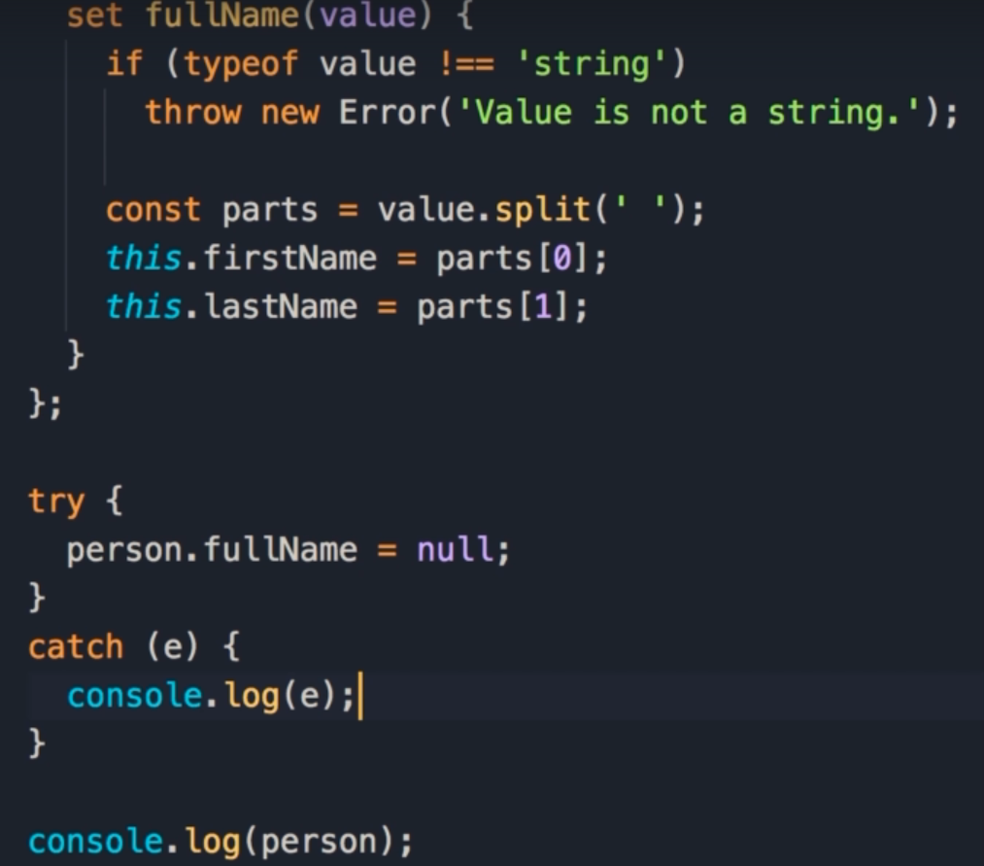
try & catch
We get the error when assigning person.fullName, so we start by wrapping that in a try block.
A try block can accept 1 or more statements, with at least 1 being able to throw an exception.
Next we add the catch block, and within parentheses, we pass an identifier.
The identifier is the error object that is thrown in the setter.
In the catch block, we get the error object and do something with it.
We can display it on the console, which is only visible to developers, so an end user will not see this error.
The proper way is to display a label, perhaps a red label on the user interface.
Notes:
Line 15 is where we receive this exception, so we need to wrap this line, in a try block, so, try, we move this line here, so try block can have 1 or more statements, one of these statements at least can throw an exception, now, we add the catch block after, in parenthesis, we give an identifier, this is the error object that we are throwing here.
So in the catch block we can get that error object and do something with it.
So here, we can display it on the console, but as you know this is only visible to developers, so an end user will not see this error, so temporarily we can use the alert function, this is not something I'd recommend you to do, because that's a very old and poor way of reporting errors to users.
The proper way is to display a label, perhaps a red label on the user interface, but that's a topic for a future video, so for now let's just use the built in alert function.

Slide 12
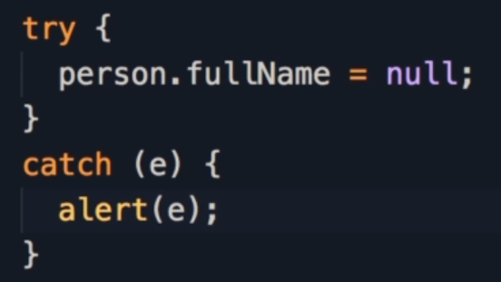
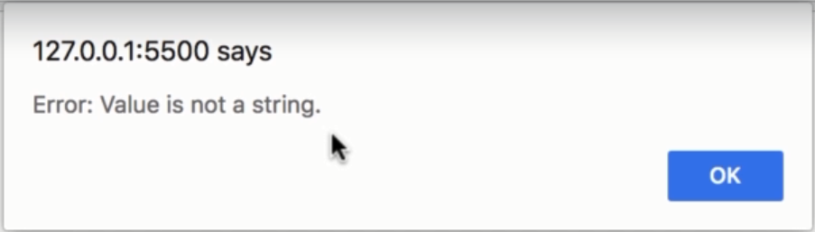
Throwing Exceptions
For now let's just use the built in alert function.
This is not something I'd recommend you to do, because that's a very old and poor way of reporting errors to users.
When you go to the browser, you should see an alert like this:
Error: Value is not a string
Notes:
Now, save the changes, and here's our alert.
Value is not a string.
Now, let's take this to the next level.

Slide 13
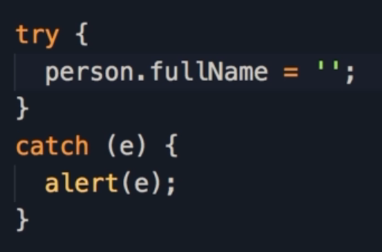
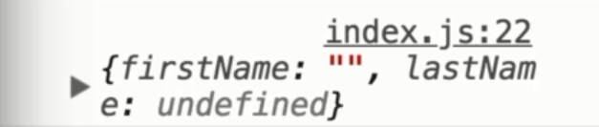
More Testing
Instead of null, lets pass in an empty string.
We don’t get an error, however firstName is set to an empty string, and lastName is undefined, which is not desirable.
Ideally we want to make sure our users enter a first name and a last name.
Notes:
Instead of passing null, I'm going to pass an empty string.
Save the changes, we don't get any errors, but first name is an empty string and last name is undefined.
Hm, again that's not desirable.
So, ideally we want to make sure that our user is typing a first name and last name.

Slide 14
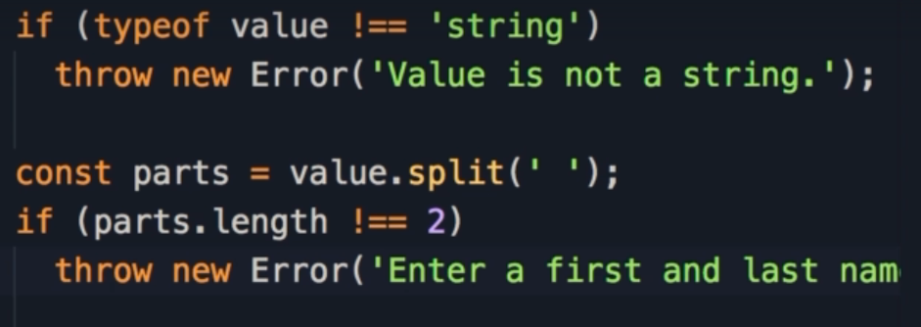
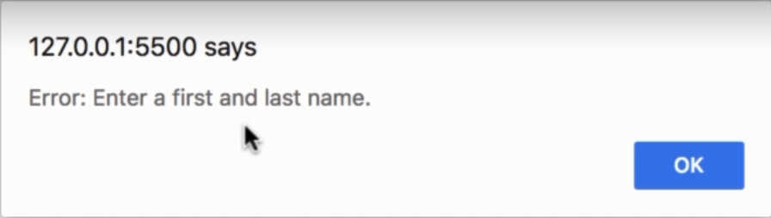
More Error Handling
When splitting the string, we can check the length of the parts array created.
Here we check if parts.length is not equal to 2, then something must be missing.
Next we throw another exception, so we throw a new Error with the message:
Enter a first and last name.
Notes:
So, when splitting that string, we can check the length of this array, so, if parts.length is not 2, that means something is missing.
So here we can throw another exception.
Throw new error, with a different message.
Enter a first and last name.
Okay, now, save the changes, and here's our new exception.
Enter a first and last name.

Slide 15
Throwing Exceptions
The throw keyword will jump out of the method, and control flow will move to the catch block, where we catch the exception and do something with it.
This is basic error handling in JavaScript
When we throw an exception, the lines after the throw statement are not executed.
Notes:
basically when we throw an exception, the lines after the throw statement are not executed.
Will jump out of this method and the control will move to the catch block.
Here we catch the exception, and do something with it.
So this is the basic of error handling in JavaScript.

